Slide 1
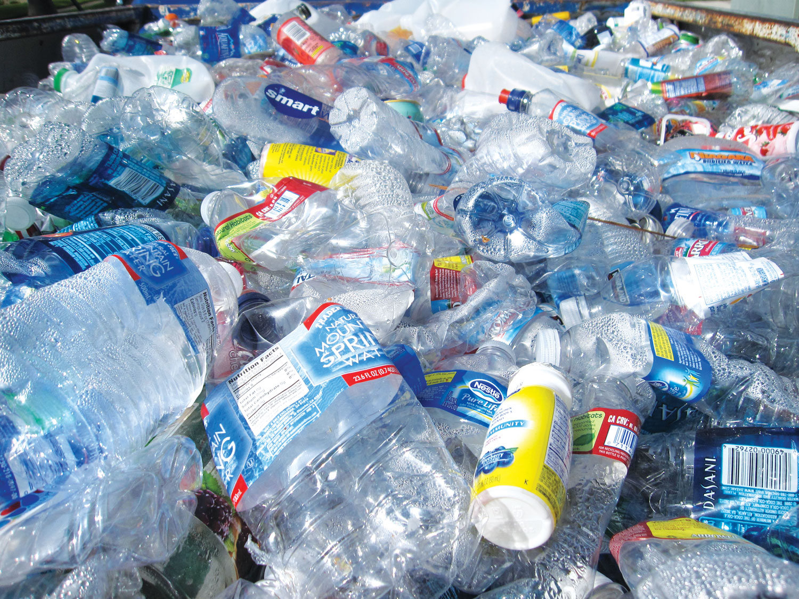
Plastic bottle Waste Management

Slide 2
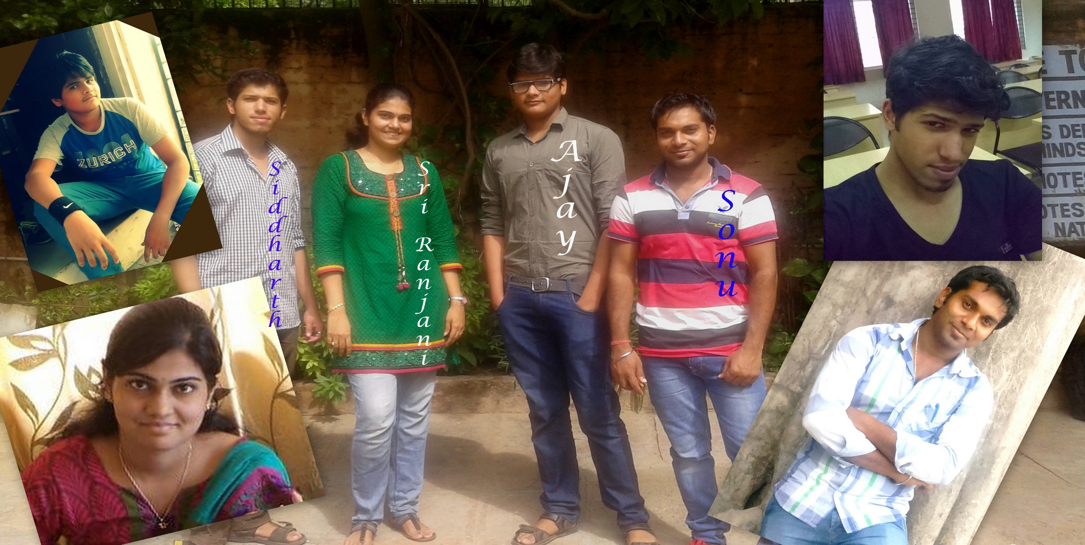
GROUP 9:MAD THRASHERS
Team Members | College name
Ajay Singh Bhadoriya(TL) | SATI,Vidisha
S.Sriranjani | Sona College,Salem
Sonu Kumar | MMU Mullana,Ambala
Siddharth Khatri | HAA, Bangalore

Slide 3
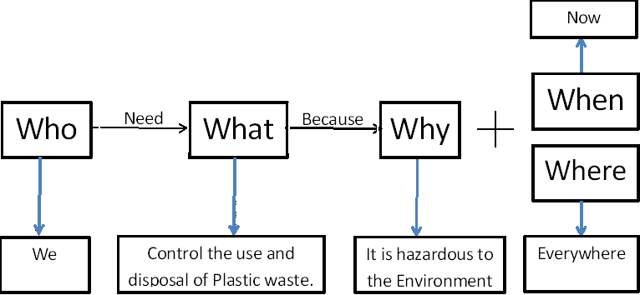
Problem statement
Public needs an alternate way for managing plastic bottles because it is non-decomposable & harmful for the environment.

Slide 4
Interesting facts about Plastics bottles
Plastic bottles are somewhat of a scourge, with 2.4 million tons of PET plastic discarded every year .
Plastic needs about 50-80 years to decompose completely. That means that every single produced piece of plastic has not decomposed yet.
Maybe more of us should be building plastic bottle houses, which are cheap to construct and surprisingly durable.
Another interesting fact about plastics and your money: 90% of the price you pay for the bottled water goes to the plastic bottle, while the water cost you only 10% of the money you give.

Slide 5
We have to solve the plastic bottles issue because it is affecting our environment.
According to a survey in 2008,In India 3 millions bottles are thrown away everyday.
What if the plastic bottles are recycled?
Yes,the plastic bottles can be collected and send for recycling to the factory.

Slide 6
No,it consumes a lot of oil and all the thrown bottle can’t be picked.
Yes,if plastic bottles can be reused then it will be better for society and environment.
If the bottles are reused for the purpose of restroom,interior designing then it will be more useful.
But…….(blank)
So lets reuse the plastic bottle for different useful purposes.

Slide 7
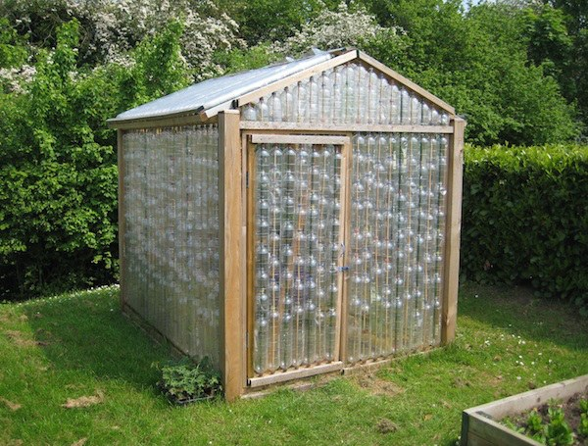
Our Solution
Creating a Restrooms in public places with plastic bottles since plastics are non-decomposable by reducing plastic trash.
A mud filled bottle is as strong as brick, so can be used for construction.
Binding Materials : Sand, Cement,Mortar,Clay etc.

Slide 8
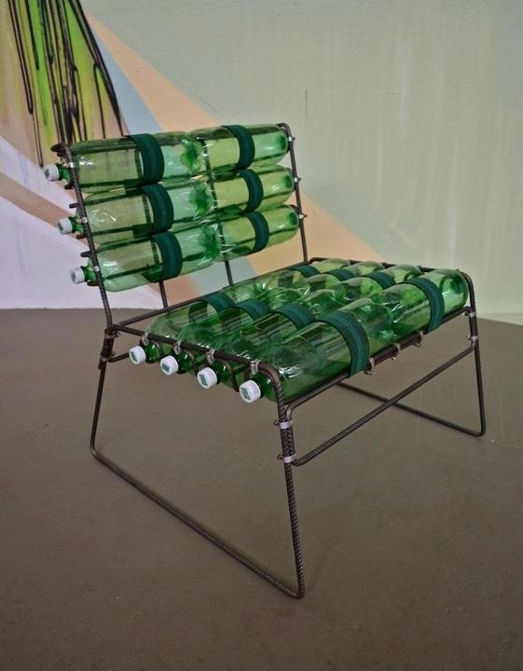
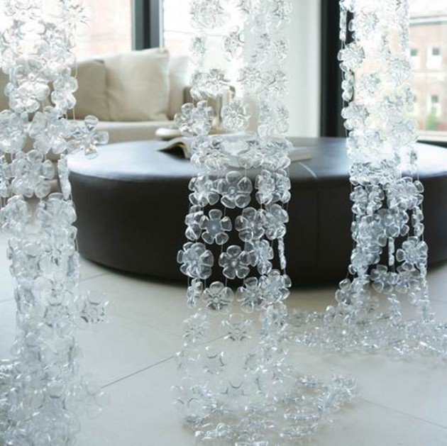
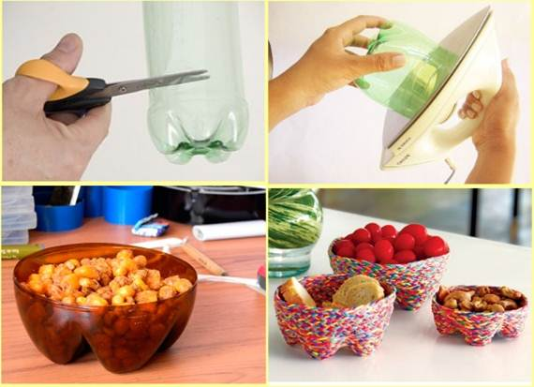
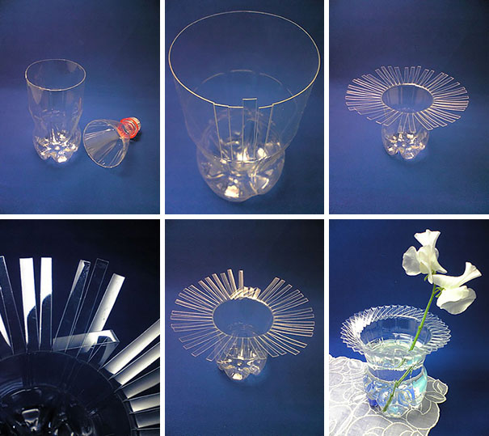
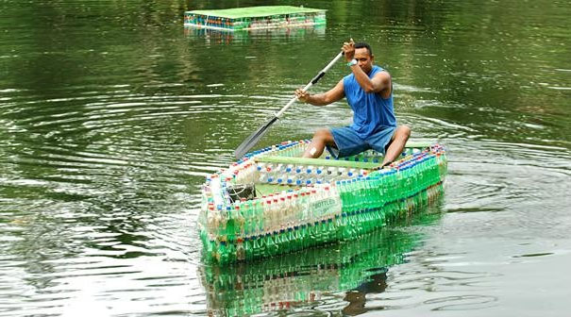
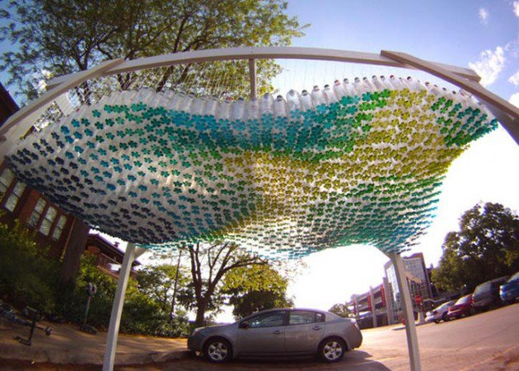
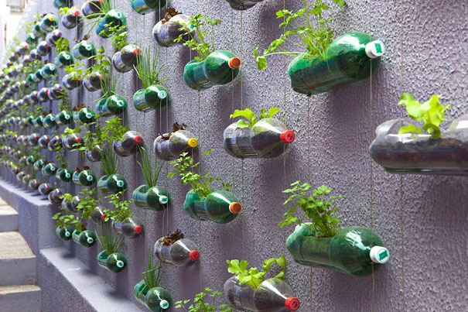
Plastic used in a Creative way

Slide 9
On Environment
Impact
On Public
* It will encourage government to make public Restrooms because of lower cost.
* New Innovative products for daily use.
It will ensure the proper reuse of plastic bottles.

Slide 10
External Help
Financial Help & permission, from the government.
Marketing help for collecting the used plastic bottles.

Slide 11
References
www.ecowatch.com
www.greenbuzzz.com
The Life Cycle of a Plastic Bottle, montgomery school.

Slide 12
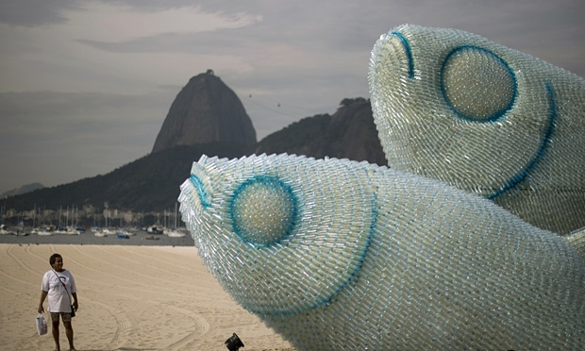
THANK U ALL

